Slide 1


Artificial Intelligence:
Intro to Python

Slide 2
Check in! ✅

Slide 3
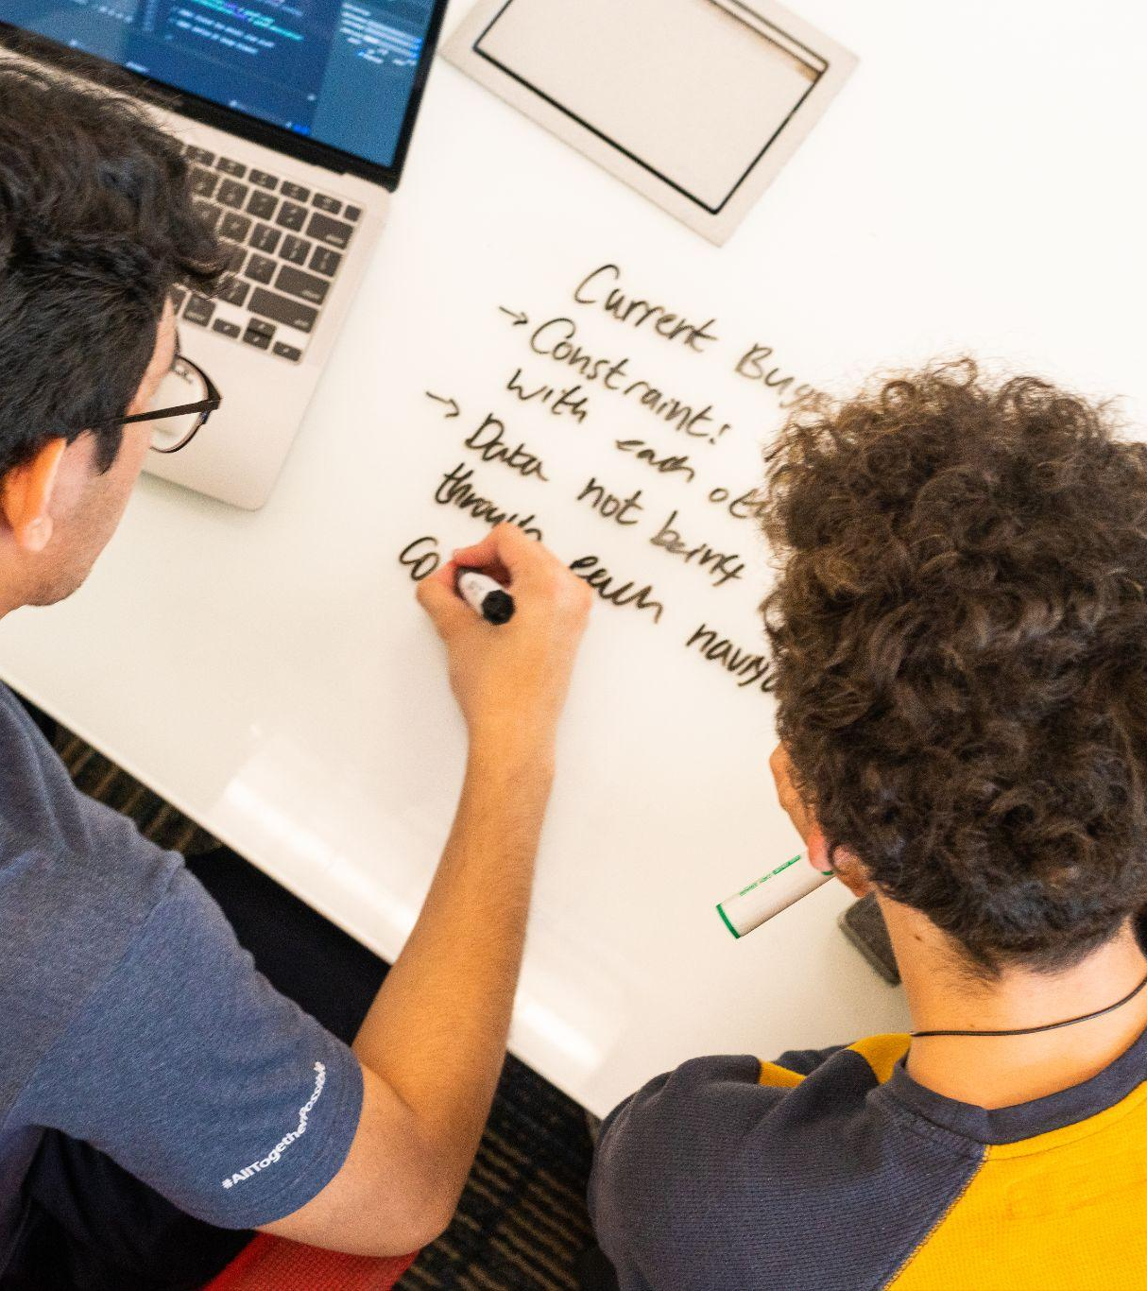
Agenda
Announcements
Installing Python
If / For & While Loops
Functions
Object Oriented Programming Basics
Libraries

Slide 4
Announcements 🚀

Slide 5

INIT FIU Membership
Membership Applications now open!
No requirements!
Membership is open and free to all FIU students
No major or experience is required!

Slide 6

Benefits
Inclusive Community
Build up Your Resume
Access to Job Opportunities
Access to Network of Companies
Industry Mentorship
Scholarships
Graduation memorabilia
Equipment Rental
Letters of Recommendation
Honors College Points

Slide 7
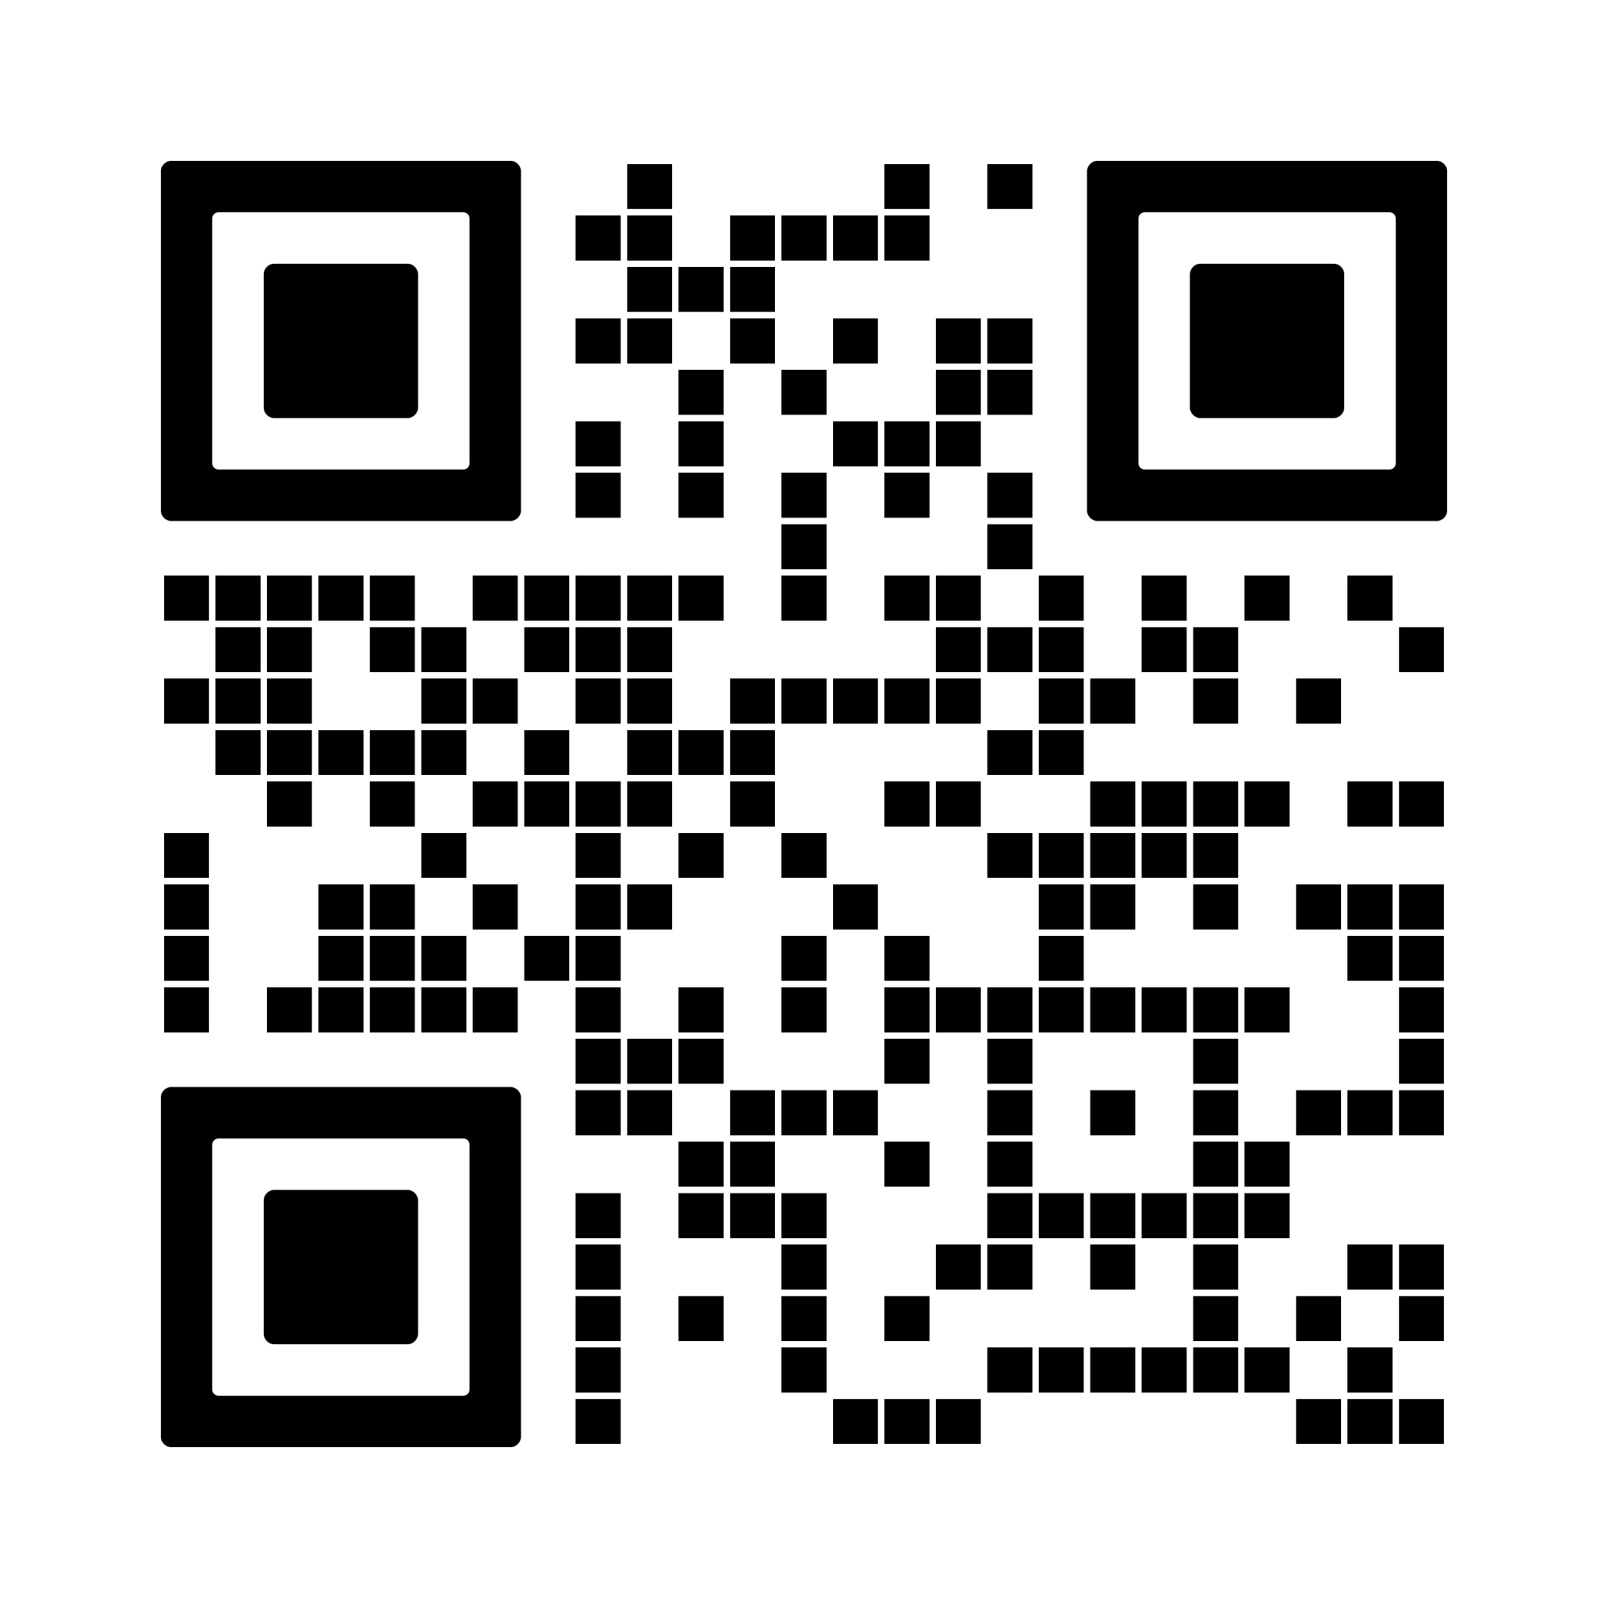
Sign Up Now!

Slide 8
Discord
INIT’s online community for all members
Get the latest news and announcements from INIT, including upcoming events
Get notified of internship and job opportunities as soon as they open
Connect with INIT alumni from top tech companies
Chat about anything from school to anime and more
Meet other students with similar interests (guilds!)

Slide 9
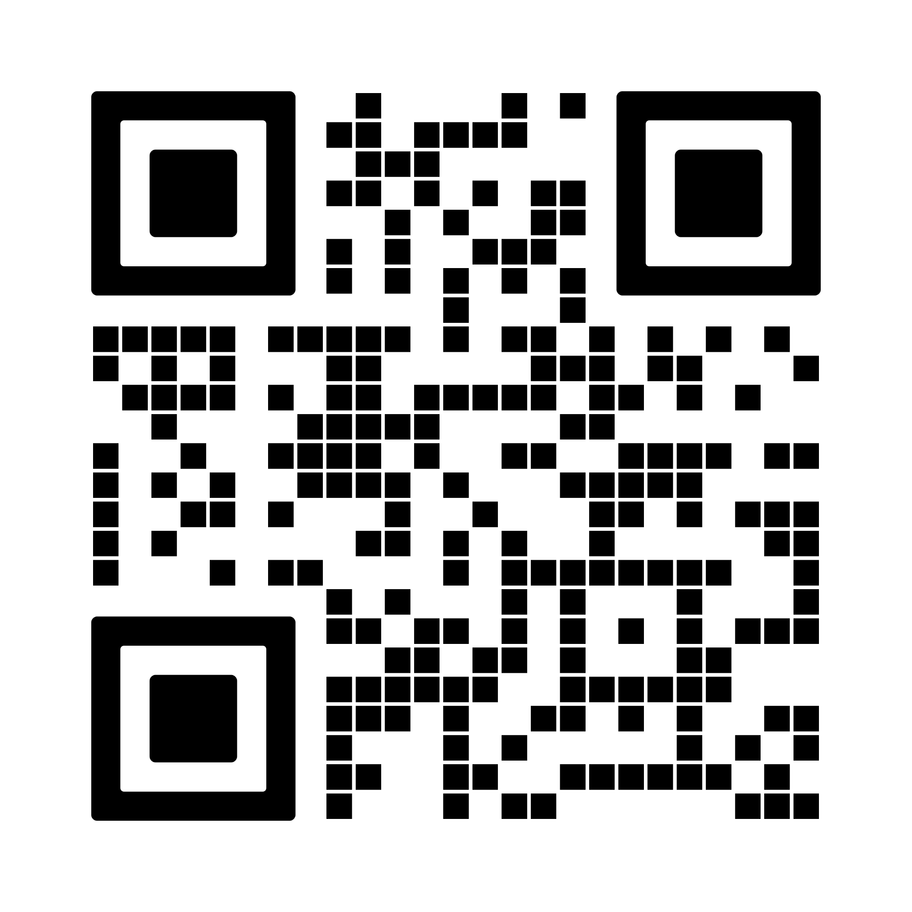
Join Now!
discord.gg/init

Slide 10
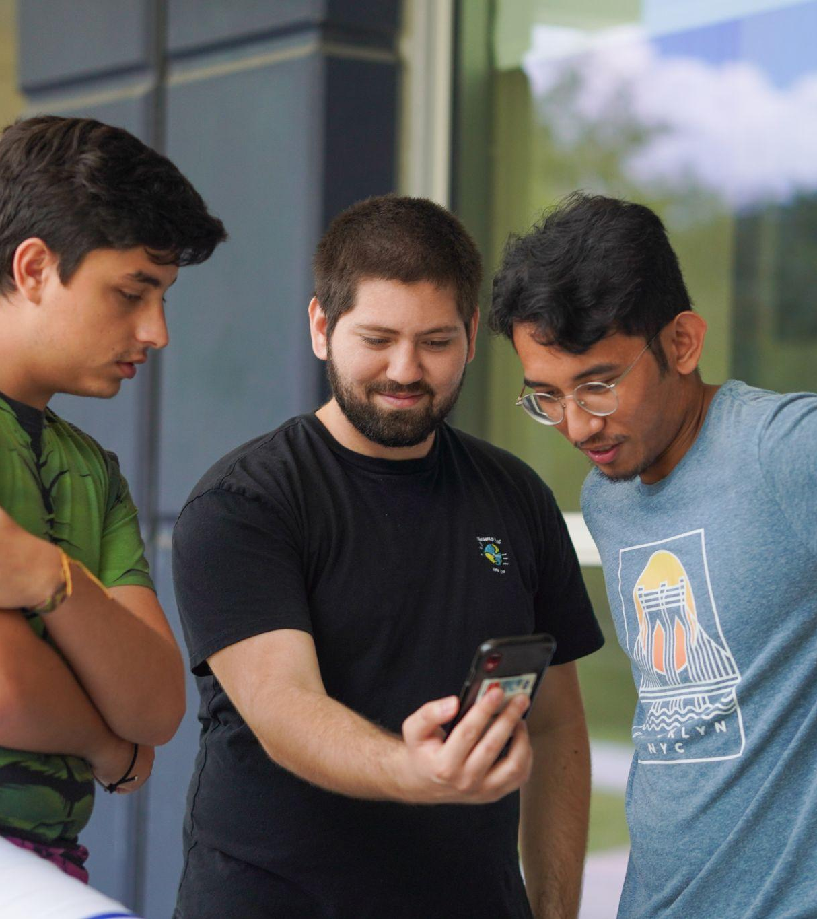
Social Media & E-mail
Instagram
@init.fiu
@initofficial, @init.alumni
LinkedIn
INIT FIU
INIT, INIT Alumni
Twitter
@init_official
E-mail
fiu@weareinit.org

Slide 11

What is INIT Explore?
Program providing technical workshops to help you learn new skills in emerging technologies
Explore Tracks
Web, Mobile, Game, AI/ML, Hardware, IT/Cybersecurity, UX/UI
Why participate?
Learn new skills you can add to your resume and help you land an internship or job

Slide 12
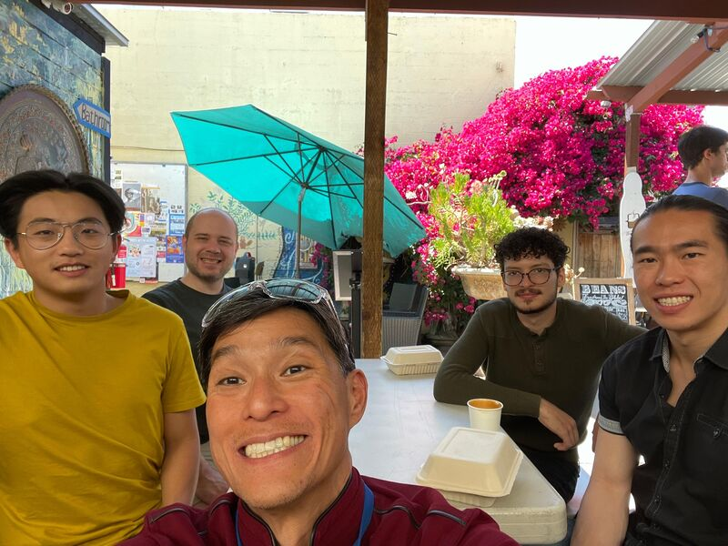



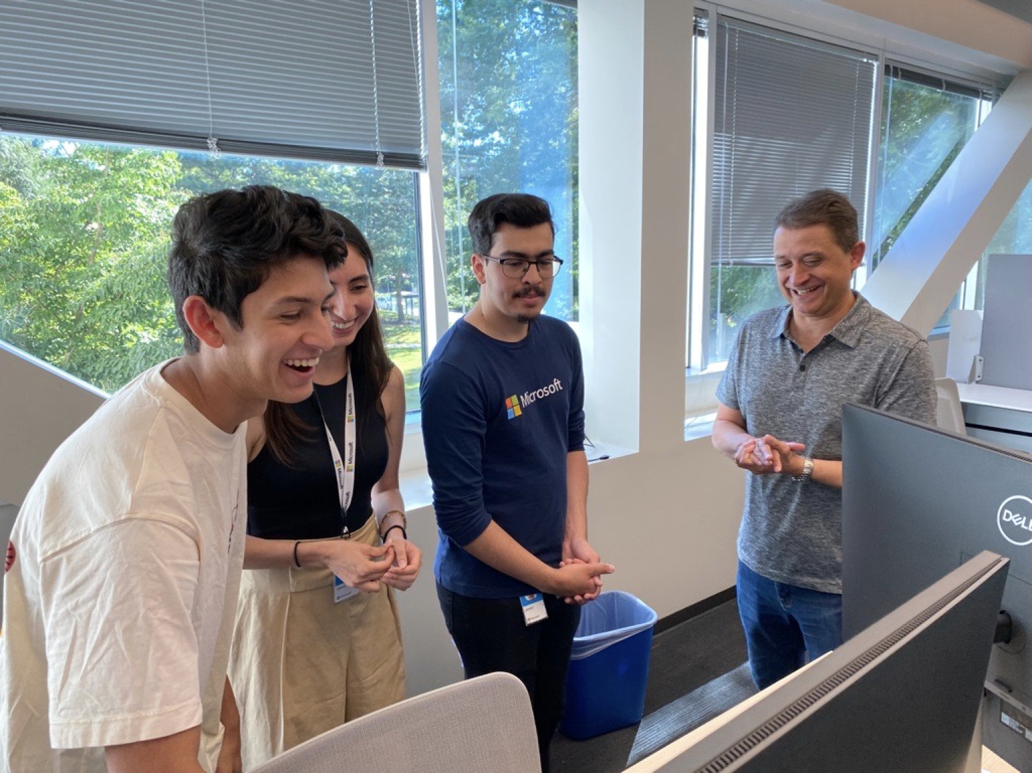



Slide 13
Installing Python 🚀

Slide 14
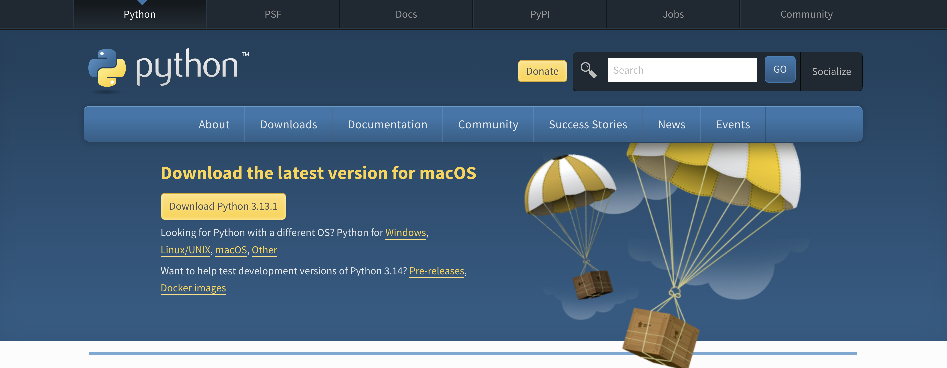
Installing Python (For any OS)
https://www.python.org/downloads/

Slide 15
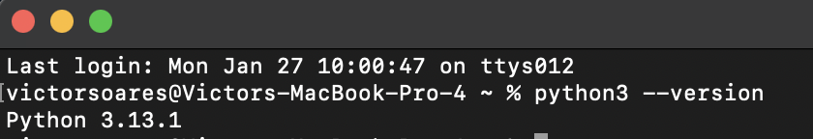
Installing Python (For any OS)
Command: “python3 –-version”

Slide 16
Installing IDE (VS Code) 🚀

Slide 17
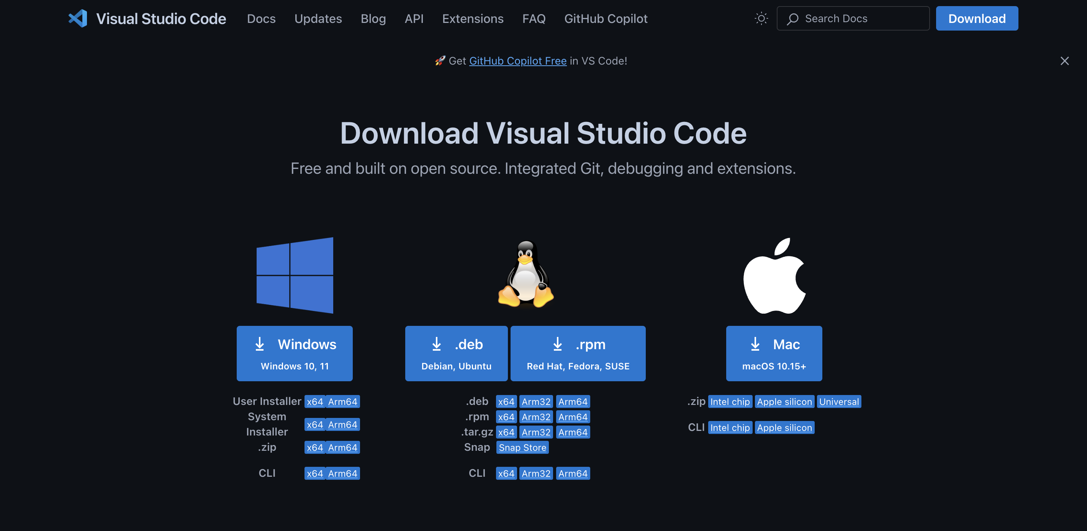
Installing VSCode (For any OS)
https://code.visualstudio.com/Download

Slide 18
Python Review 🚀

Slide 19
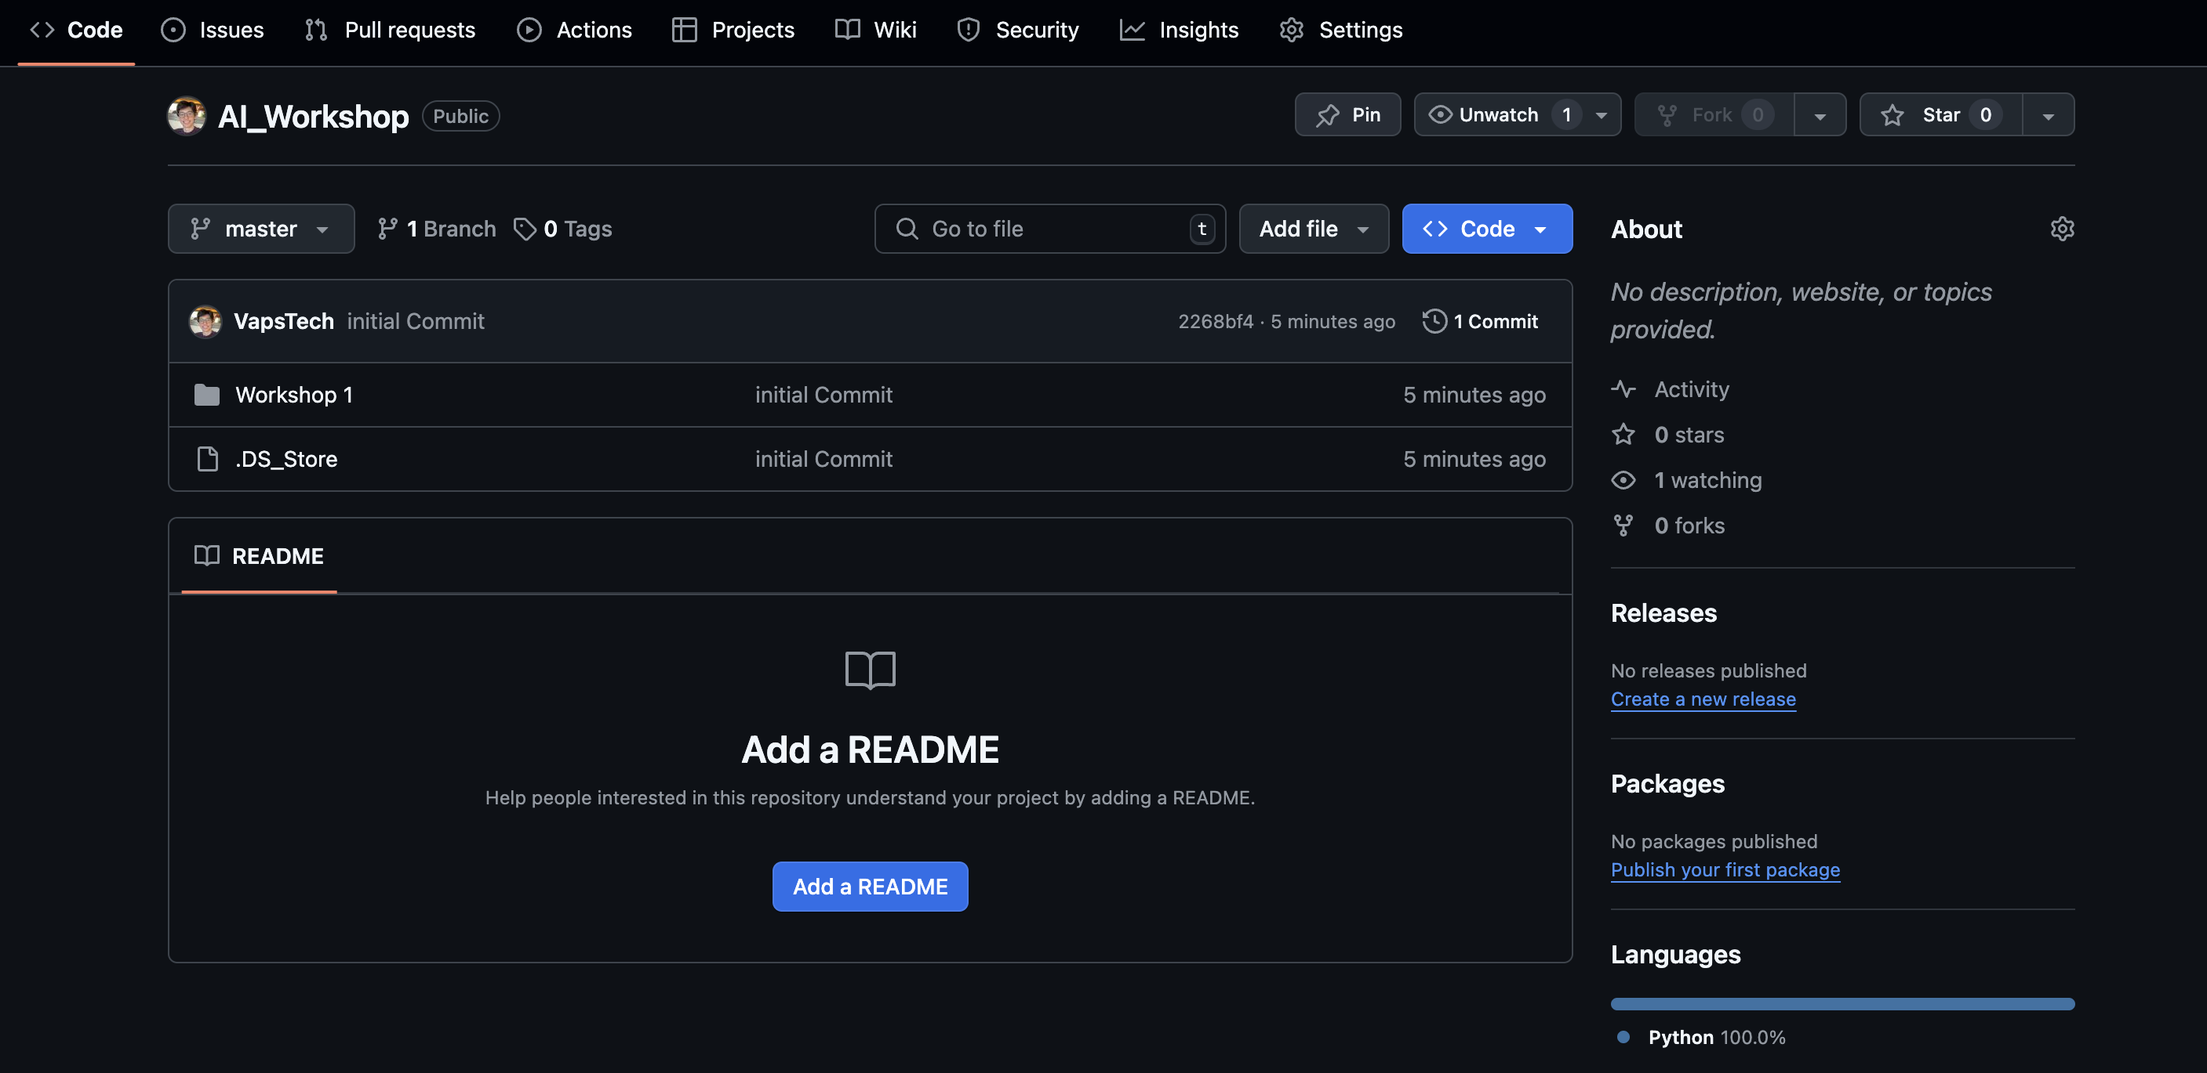
Accessing Code in GITHUB
https://github.com/VapsTech/AI_Workshop/tree/master

Slide 20
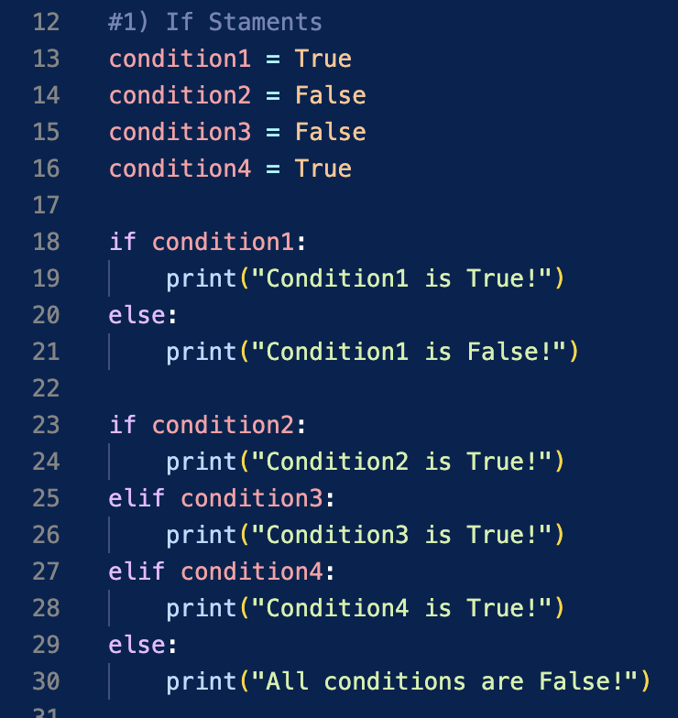
If Statements
if-else:
Logical Operation that executes a block of code on whether a condition is True or False
elif:
Statement that is used to include more conditions with different blocks of code inside each condition

Slide 21
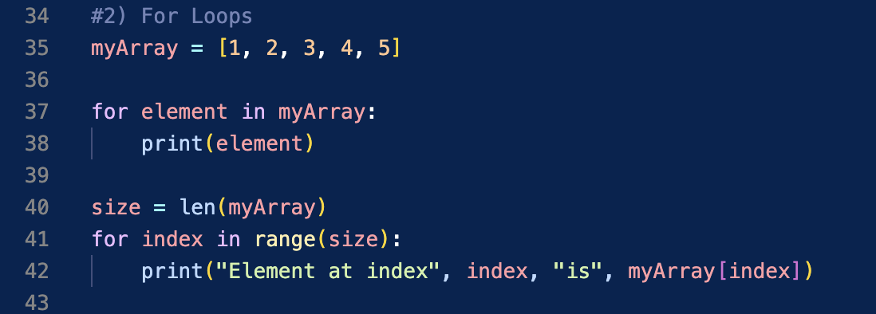
For Loops
How you can use For Loops:
Used to repeat a block of code for each next item in a sequence
You can use for loops to iterate through the items in a list, range or dictionary

Slide 22
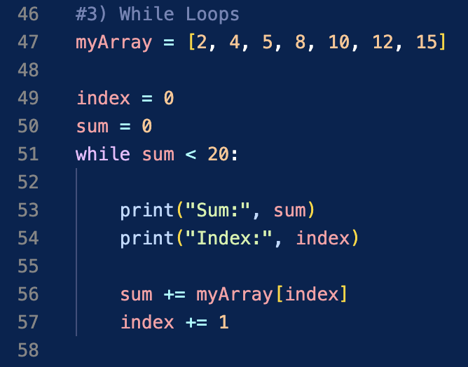
While Loops
How you can Use While Loops
Used to keep repeating a block of code as long as a condition is TRUE
So, it checks the condition before executing the block of code

Slide 23
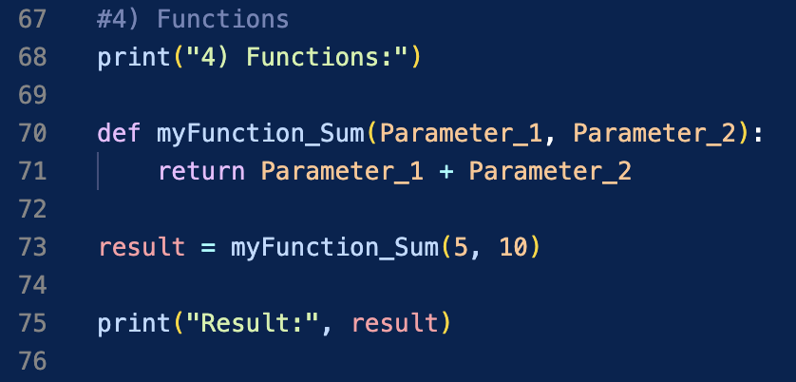
Functions
What is a function?
A function is a piece of instruction to perform a task
Functions are useful because they make a program smaller and easier to manage
They can take Parameters and can return values

Slide 24
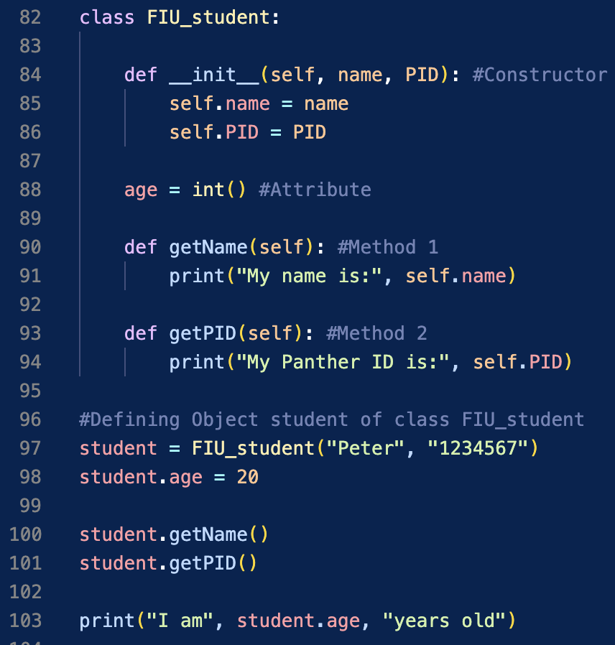
Object-Oriented-Prog
What is OOP?
Object-Oriented-Programming (OOP) is a way of organizing data
Ein OOP, you have an Object (student) of a class (FIU_student)
The Object of some class has access to its methods (functions of the class) and attributes (variables of the class)

Slide 25
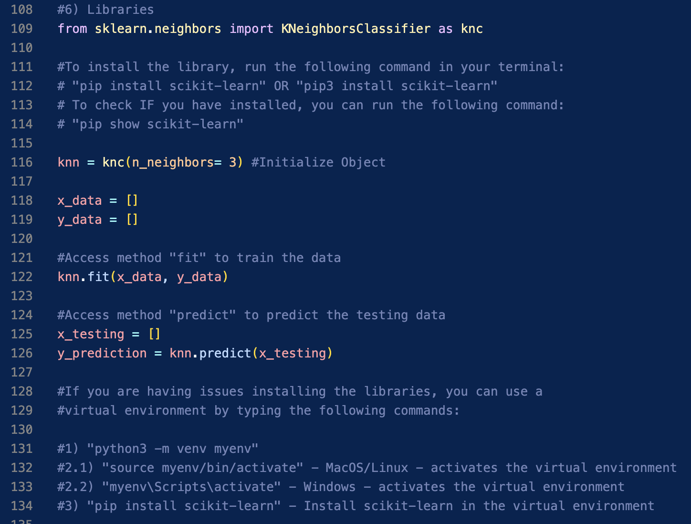
Libraries
What is a library?
Libraries are code that we can have access to without having to write them in our code
Why to use a library?
They are useful because we can have access to complex functions already made by other people

Slide 26
Thank you! 🎉

